Slide 1
Chapter 6
Systems Analysis and Design in a Changing World, 7th Edition - Chapter 6 ©2016. Cengage Learning. All rights reserved.

Slide 2
Foundations for Systems Design
Chapter 6
Systems Analysis and Design in a Changing World 7th Ed
Satzinger, Jackson & Burd

Slide 3
Chapter 6: Outline
What Is Systems Design?
Design Activities
System Controls and Security

Slide 4
Learning Objectives
Describe systems design and contrast it with systems analysis
List the documents and models used as inputs to or output from systems design
Explain each major design activity
Describe security methods and controls

Slide 5
Overview
Analysis says “what” is required and design tells us “how” the system will be configured and constructed
Chapters 2, 3, 4 and 5 covered systems analysis activities (requirements)
This chapter introduces system design and the design activities involved in systems development
Design bridges the gap between requirements to actual implementation

Slide 6
What is Systems Design
Analysis provides the starting point for design
Design provides the starting point for implementation
Analysis and design results are documented to coordinate the work
Objective of design is to define, organize, and structure the components of the final solution to serve as a blue print for construction

Slide 7
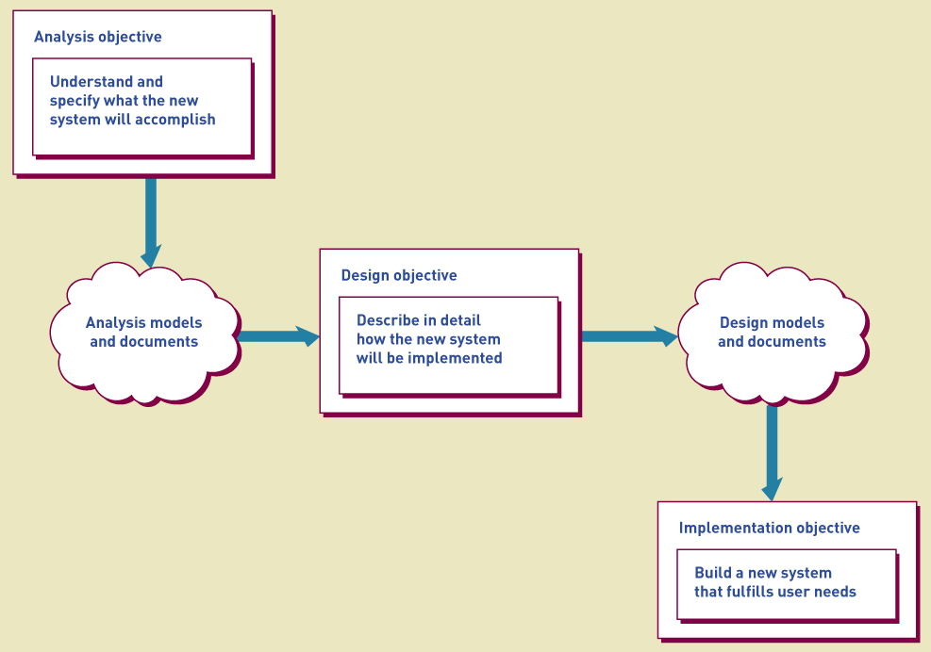
Analysis to Design to Implementation

Slide 8
Design Models
Design is a model building activity
The formality of the project will dictate the type, complexity, and depth of models
Agile/iteration projects typically build fewer models, but models are still created
Jumping to programming without design often causes less than optimum solutions and may require rework

Slide 9
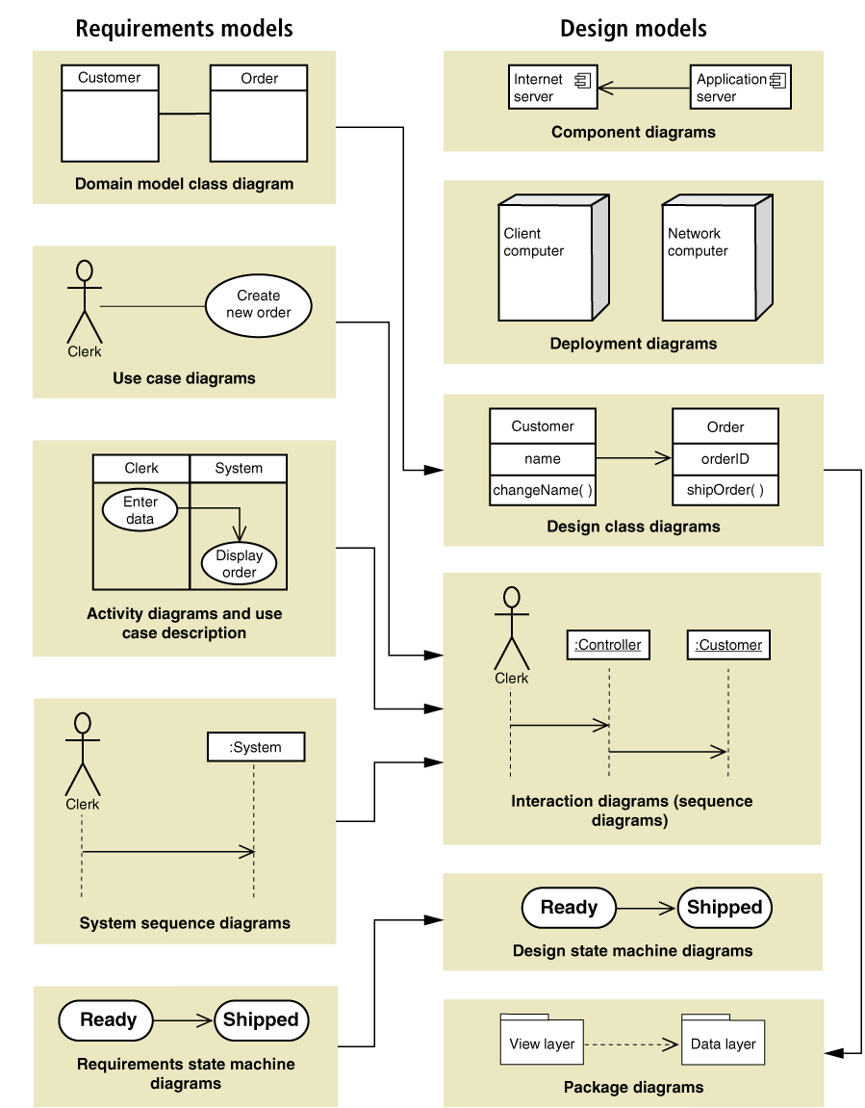
Analysis Models to Design Models

Slide 10
Design Activities
Design activities correspond to components of the new system
The environment
Application components
User interface
Database
Software classes and methods

Slide 11
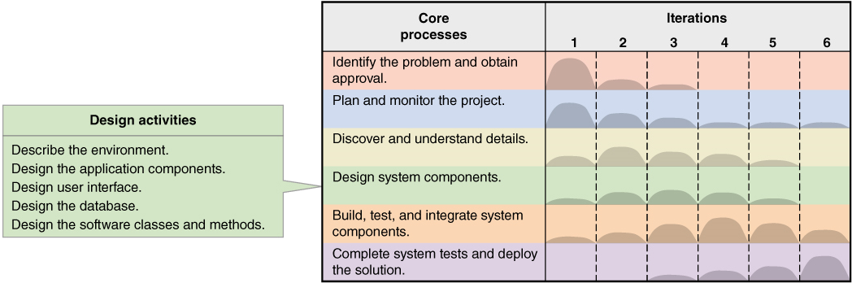
Design Activities and Iterations

Slide 12
Key Design Questions for each Activity
Design activity | Key question
Describe the environment | How will this system interact with other systems and with the organization’s existing technologies?
Design the application components | What are the key parts of the information system and how will they interact when the system is deployed?
Design the user interface | How will users interact with the information system?
Design the datebase | How will data be captured, structured, and stored for later use by the information system?
Design the software classes and methods | What internal structure for each application component will ensure efficient construction, rapid deployment, and reliable operation?

Slide 13
Describe the Environment
Two key elements in the environment
Communications with External Systems
Message formats
Web and networks
Communication protocols
Security methods
Error detection and recovery
Conforming to an existing Technology Architecture
Discover and describe existing architecture
Chapter 7 provides more details

Slide 14
Design the Application Components
Application component is a well defined unit of software that performs some function(s)
Issues involve how to package components including
Scope and size – what are the functions, boundaries, interfaces?
Programming language – what are the accepted languages?
Build or buy – is an acceptable version available to purchase?

Slide 15
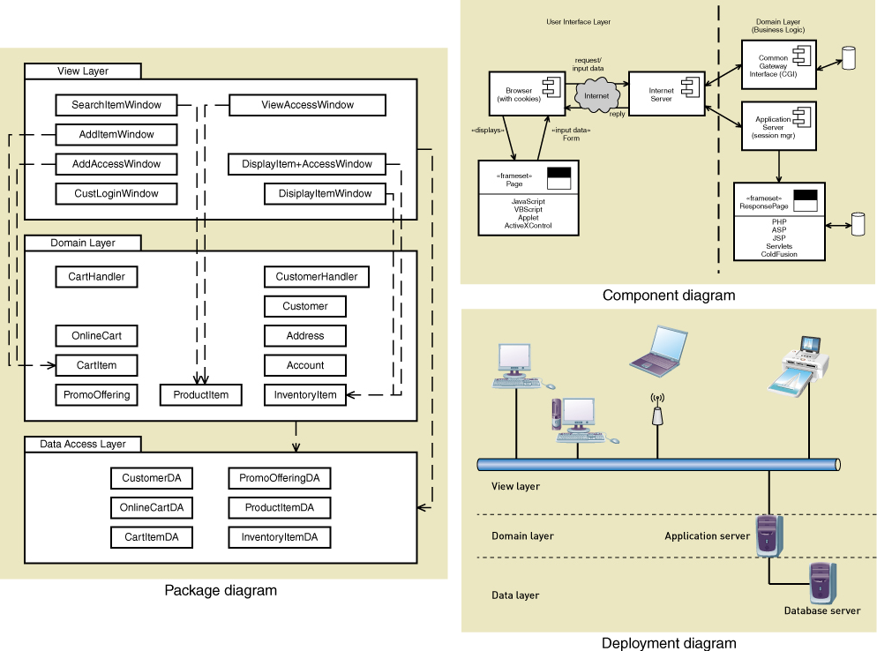
Typical models for defining application components

Slide 16
Design the User Interface
To the user, the User Interface is the system.
The user interface has large impact of user productivity
Includes both Analysis and Design tasks
Requires heavy user involvement
Current needs require multiple user interfaces
Many different devices and environments

Slide 17
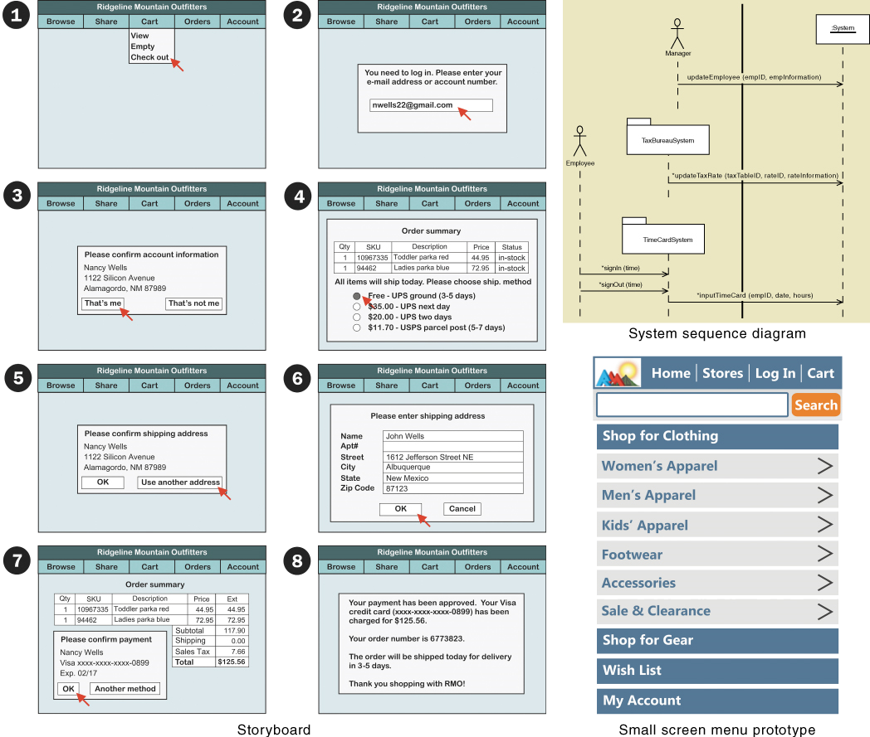
Typical models for user interface design

Slide 18
Design the Database
By definition, an Information System requires data – usually in a database
Current technology frequently use Relational Database Management Systems (R D B M S)
Requires converting the data model to a relational database
Requires addressing of many other technical issues
Throughput and response time
Security

Slide 19
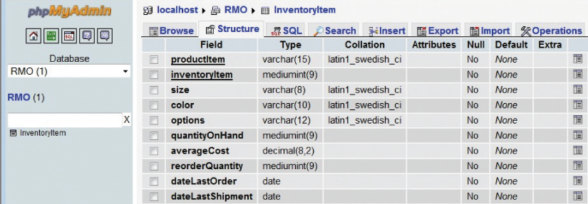
Typical Table Definition as part of Database Schema

Slide 20
Design Software Classes and Methods
A K A Detailed Design
A model building activity
Design Class Diagram
Sequence Diagrams
State-Machine Diagrams

Slide 21
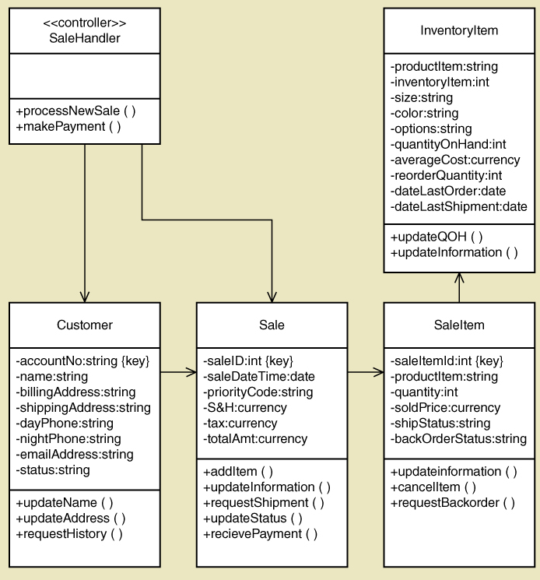
Typical Design Class Diagram with attributes and methods

Slide 22
System Controls and Security
Integrity Controls
Controls that maintain integrity of inputs, outputs and data and programs
Security Controls
Controls that protect the assets from threats, internal and external

Slide 23
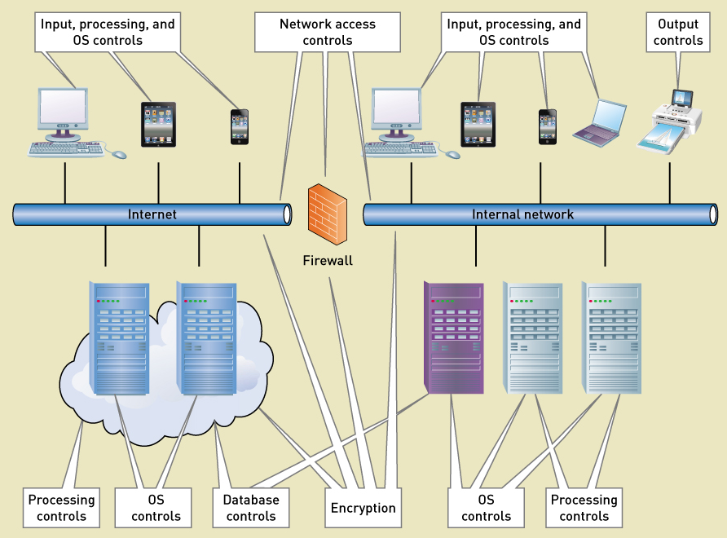
Integrity and Security Controls

Slide 24
Designing Integrity Controls
Integrated into application programs and D B M S
Objectives of Integrity Controls
Ensure that only appropriate and correct business transactions are accepted
Ensure that transactions are recorded and processed correctly
To protect and safeguard assets such as the database

Slide 25
Input Controls
Prevent invalid or erroneous data from entering the system
Value Limit Controls
Check the range of inputs for reasonableness
Completeness Controls
Ensure all the data has been entered
Data Validation Controls
Ensure that specific data values are correct
Field Combination Controls
Ensure data is correct based on relationships between fields

Slide 26
Output Controls
To ensure that output arrives at proper destination (for authorized eyes) and is accurate, current, and complete
Examples
Physical access to printers and display devices
Discarded data – protect from “dumpster diving”
Labels on printed and electronic output to correctly identify source of data

Slide 27
Redundancy, Backup and Recovery
Protect data and systems from catastrophes
Databases
Hardware
Software applications
Networks
On-site versus off-site copies

Slide 28
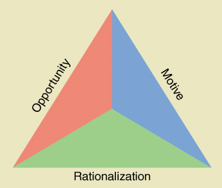
Fraud Prevention
Critical to prevent internal fraud, embezzlement, or loss
Fraud triangle
Opportunity
Motive
Rationalization

Slide 29
Fraud Risk – Factors and Techniques
Factors affecting fraud risk | Risk-reduction techniques
Separation of duties | Design systems so those with asset custody have limited access to related records. Also, ensure that no one has sufficient system access to commit and cover up a fraud.
Records and audit trails | Record all transactions an changes in asset status. Log all changes to records and databases, and restrict log access to a few trusted persons.
Monitoring | Incorporate regular and systematic procedures to review records and logs for unusual transactions, accesses, and other patterns.
Asset control and reconciliation | Limit physical access to valuable assets, such as inventory, and periodically reconcile physical asset counts with related records.
Security | Design security features into individual systems and supporting infrastructure. Review and test security features frequently. Use outside consultants to conduct penetration testing attack and fraud vectors from external and internal sources.

Slide 30
Designing Security Controls (1 of 2)
Protect all assets against external threats
Other objectives
Protect and maintain a stable, functioning operating environment 24/7 (equipment, operating systems, D B M S s)
Protect information and transactions during transmission across networks and Internet

Slide 31
Designing Security Controls (2 of 2)
Access Controls – Limit a person’s ability to access servers, files, data, applications
Authentication – to identify users
Multifactor Authentication
Access control list – list of valid users
Authorization – authenticated user’s list of permission level for each resource
Registered Users – those with authorization
Unauthorized Users – anyone not registered
Privileged Users – those that maintain lists and systems

Slide 32
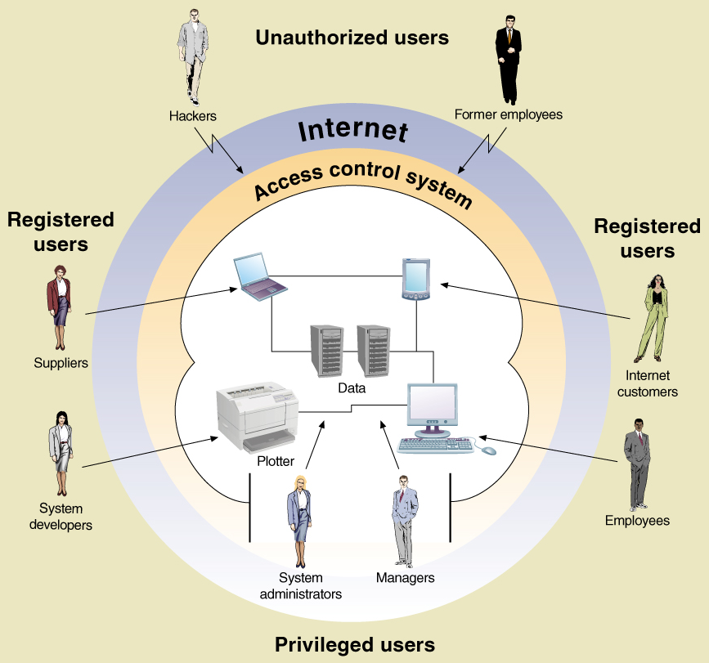
Types of users

Slide 33
Data Encryption
Method to secure data – stored or in transmission
Encryption – alter data so it is unrecognizable
Decryption – converted encrypted data back to readable format
Encryption Algorithm – mathematical transformation of the data
Encryption Key – a long data string that allows the same algorithm to produce unique encryptions

Slide 34
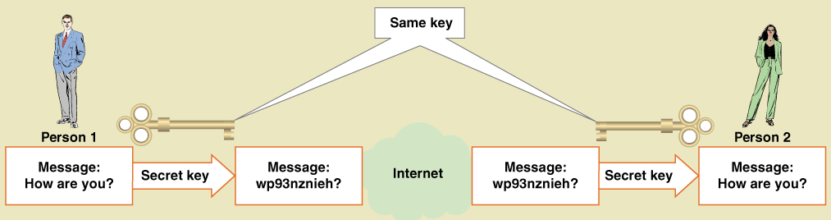
Symmetric Key Encryption
Encryption method that uses the same key to encrypt and decrypt

Slide 35
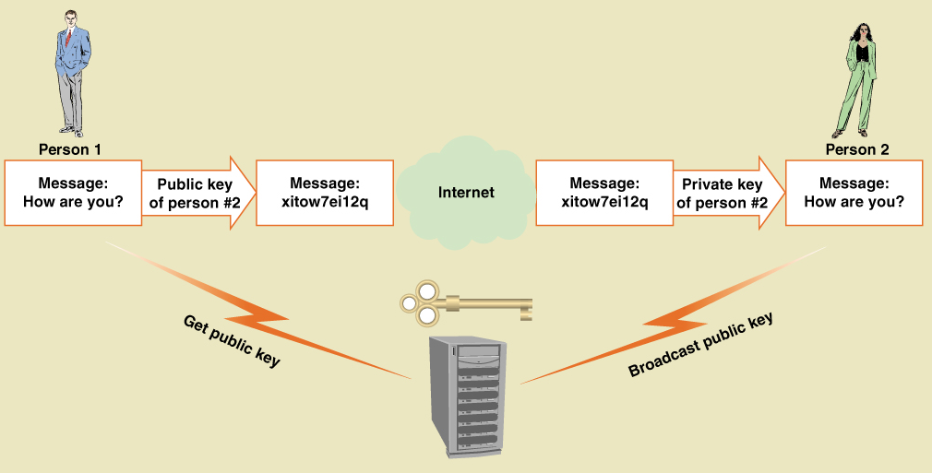
Asymmetric Key Encryption
Encryption method that uses different keys to encrypt and decrypt
A K A Public Key Encryption

Slide 36
Digital Signatures and Certificates
Digital Signature – technique where a document is encrypted using a private key
Note – implements previous slide, but in reverse
Document is encrypted with private key, but then can only be decrypted with correct public key
Digital Certificate – An organizations name and public that is encrypted and certified by an authorized third party
Certifying Authority – the authorized third party
Widely known and accepted – built into Web browsers

Slide 37
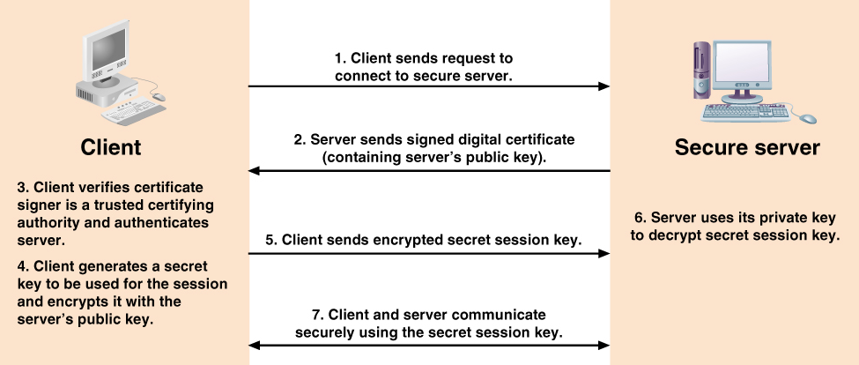
How a Digital Certificate is used

Slide 38
Secure Transactions
Secure Sockets Layer (S S L) – standard set of protocols for authentication and authorization
Transport Layer Security (T L S) – an Internet standard equivalent to S S L
I P Security (I P Sec) – Internet security protocol at a low-level transmission
Hypertext Transfer Protocol Secure (H T T P S) – Internet standard to transmit Web pages

Slide 39
Summary (1 of 3)
This chapter introduces the concept of Systems Design
Analysis is fact finding and modeling
Design is modeling to specify how system will be implemented
Design is bridge between analysis an implementation

Slide 40
Summary (2 of 3)
Activities of Systems Design
Describe the environment
Design the application components
Design the User Interface
Design the database
Design the software classes and methods

Slide 41
Summary (3 of 3)
System Controls and Security
Integrity Controls
Input controls
Output controls
Backup and recovery
Fraud prevention
Security Controls
Access controls
Data encryption
Digital signatures and certificates
Secure transactions

